Slide 1
Greater Madison Area PCC
3902 Milwaukee St
Madison, WI 53714
FIRST-CLASS MAIL
Postage & Fees
PAID
USPS
PERMIT NO.
G-10
We're refreshing
our membership list
Confirm your contact info
on the back!
Get Connected and Grow

Slide 2
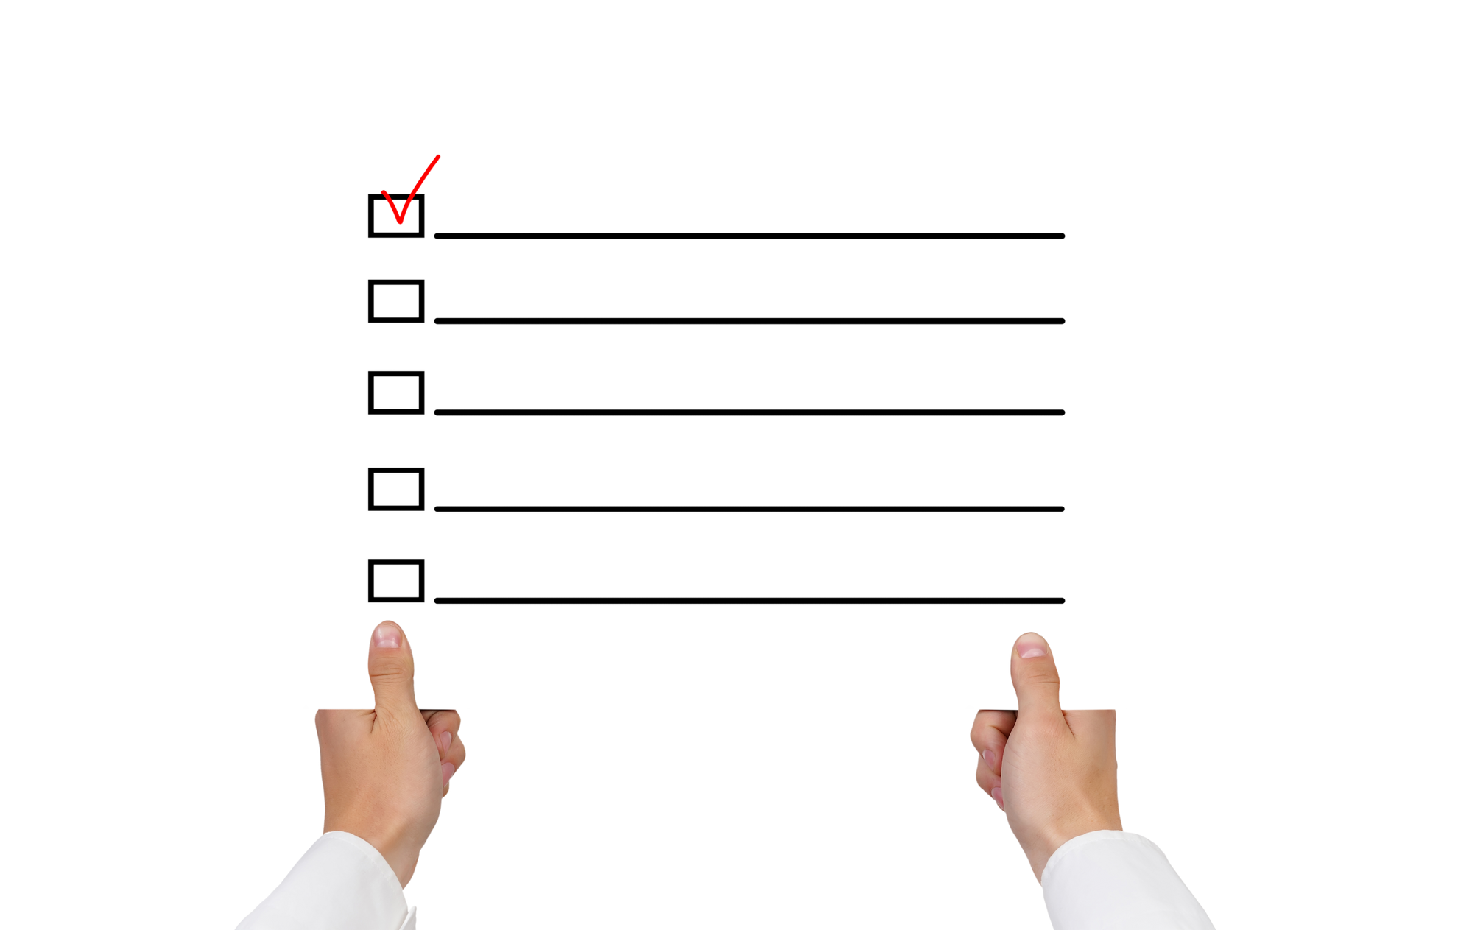
Please email Jeff at Jeffery.L.Braaksma@usps.gov
and confirm the following information:
Need to correct
your membership
info?
Name, Title
Know someone who could benefit from membership?
Company Name
Just tell Jeff!
Mailing Address
Just tell Jeff!
Email
Phone no.
Just tell Jeff!
Today!
Get Connected and Grow
www.madisonpcc.com

